Slide 1

Automated Artificial Intelligent Customer Service Assistant (AAICS)
Github: https://github.com/ZaraPezi/Software-Project-Management/tree/main
Presented by:
Zahra Pezeshki
Sahran Khuwaja
Yug Ritesh Kotak
Omnia Alam
Winter 2024

Slide 2


Introduction
Traditional customer service tools struggle to:
meet the diverse needs of modern consumers
resulting in frustration
Inefficiency
missed opportunities.
Traditional chatbots often fall short, leaving customers dissatisfied and businesses struggling to keep up with evolving demands.
AAICS promises to revolutionize customer service operations, particularly within banking and finance, by leveraging NLP, Speech Recognition, and Machine Learning technologies.
The challenge presents an opportunity to redefine customer service, bridge the gap between businesses and customers, and establish a new standard for excellence.

Slide 3
Introduction
Goal
Problem
Opportunity
- Inefficiencies and limitations of traditional customer service approaches
- Struggles with handling complex inquiries, language barriers, and maintaining context
- Potential frustration, delays, and dissatisfaction experienced by customers
- Particularly prominent within the financial and banking sectors
- Reflects the need for a more advanced and effective solution to meet evolving customer needs
Revolutionizing Customer Service Operations
- Revolutionizing Customer Service
- Overcoming Limitations
- Enhancing Customer Experience
- Improving Operational Efficiency
- Expanding Across Industries

Slide 4



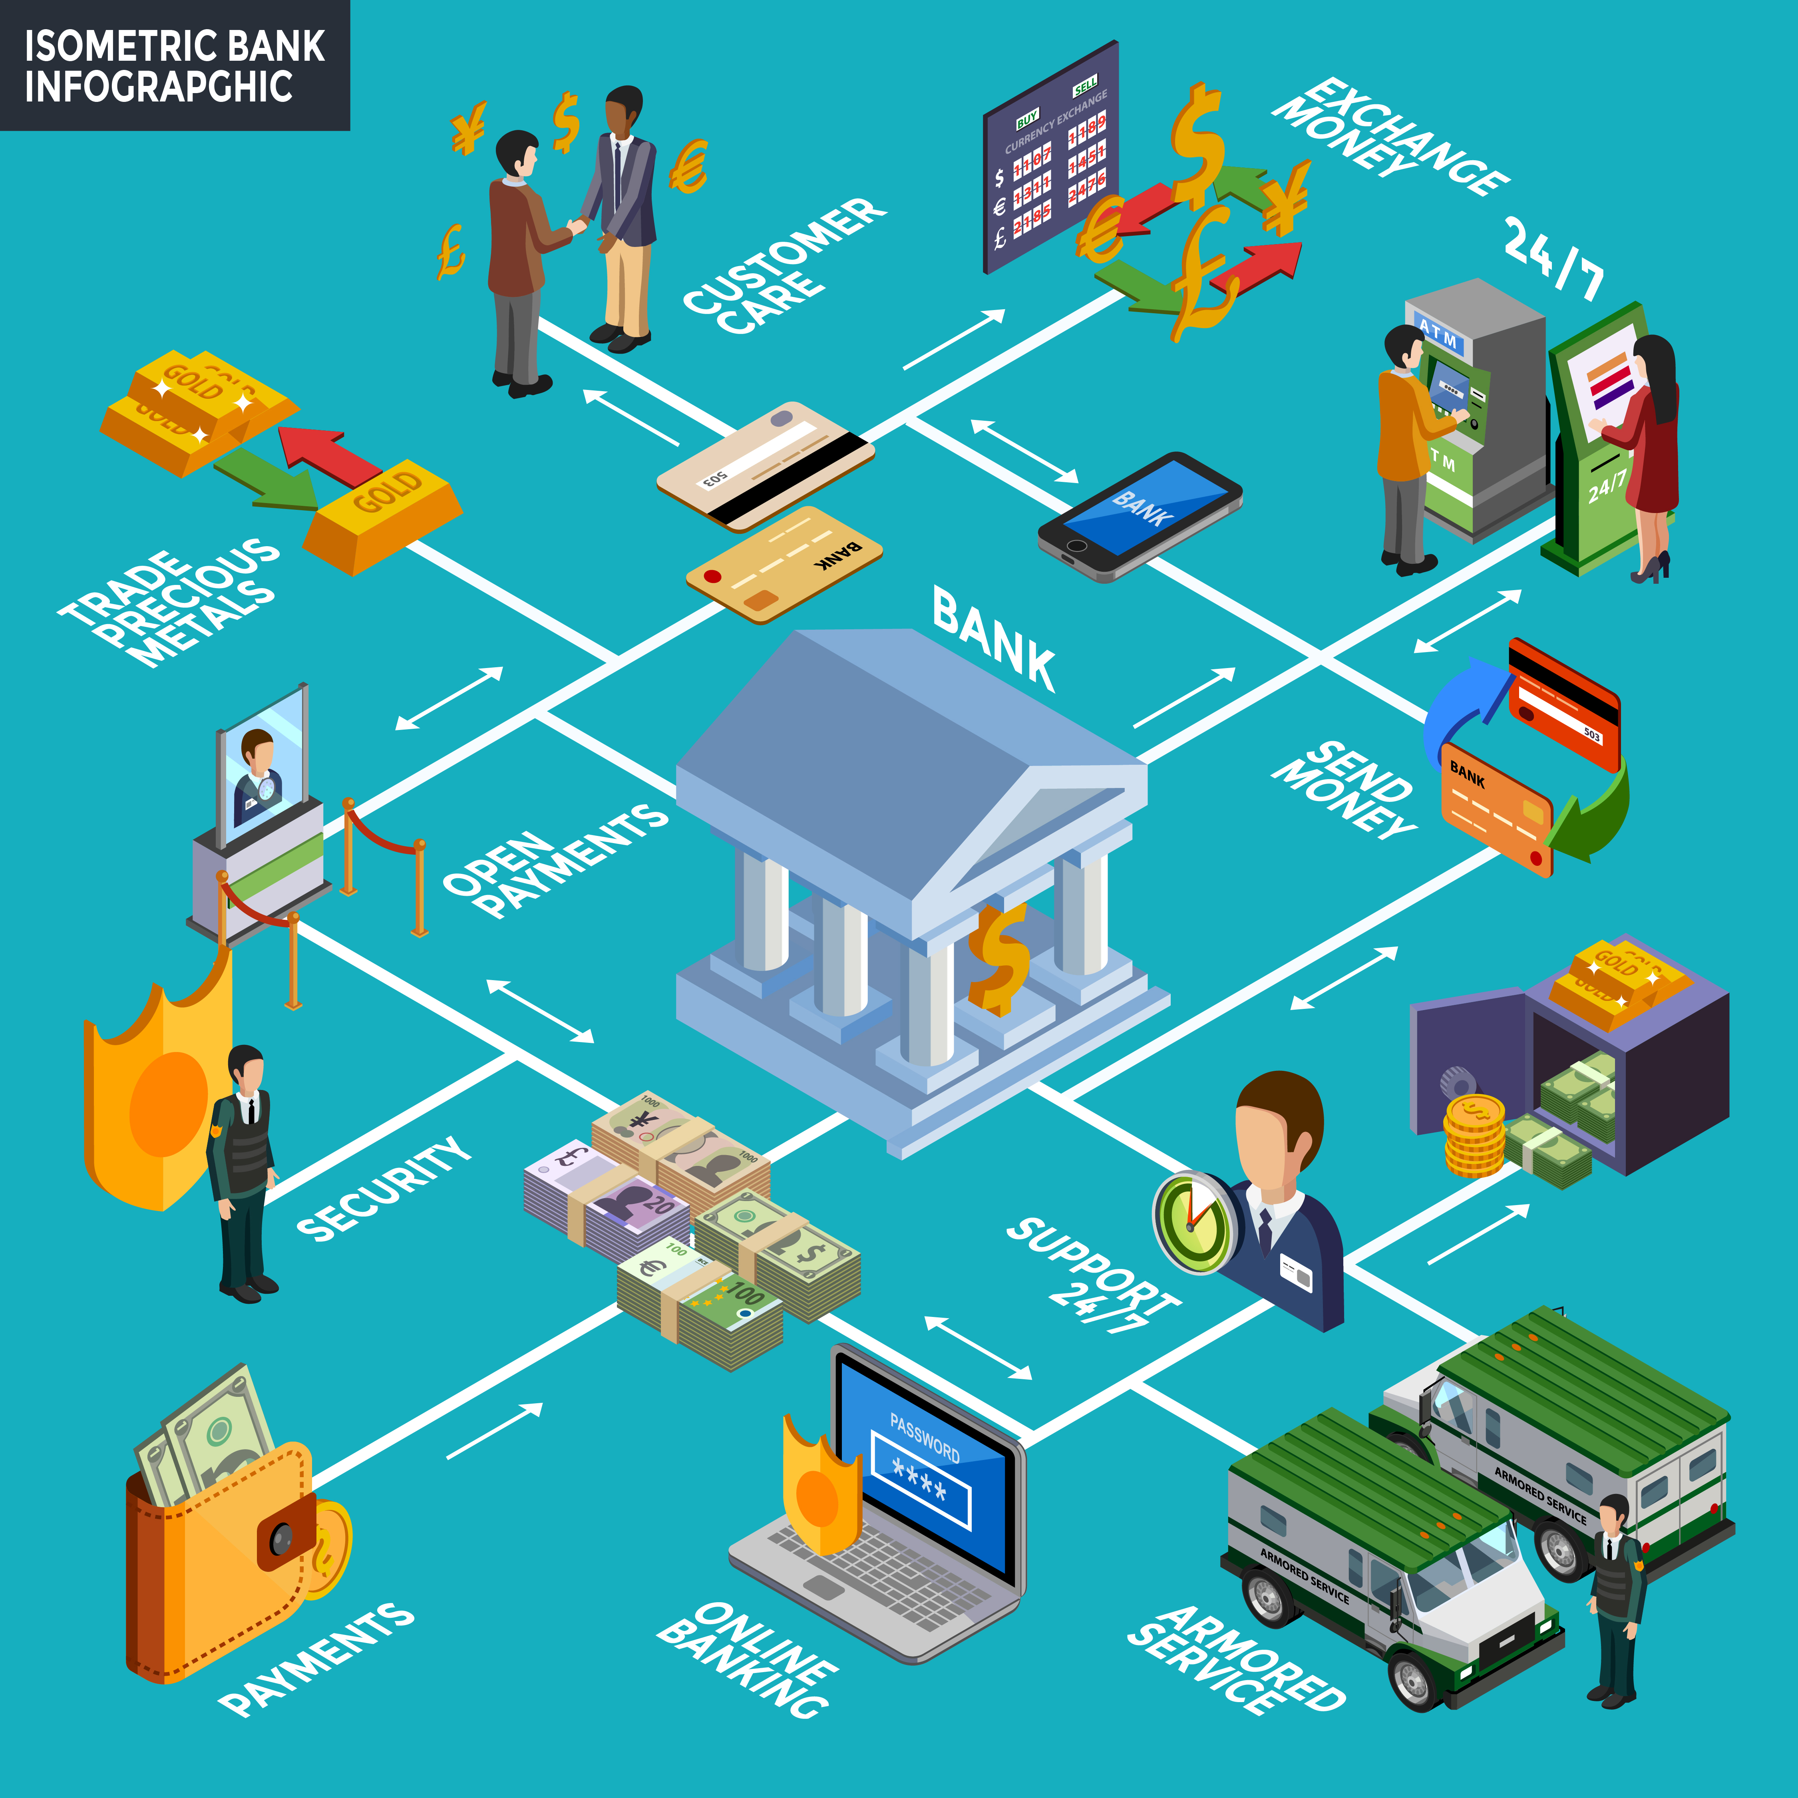
Application Areas(Current Scope)
Banking Services

Slide 5


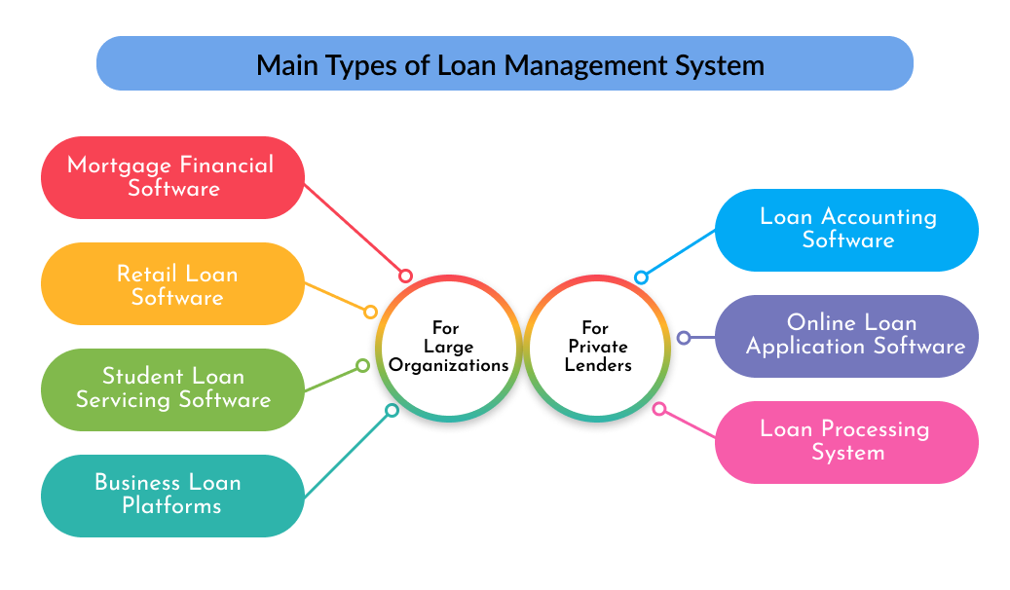


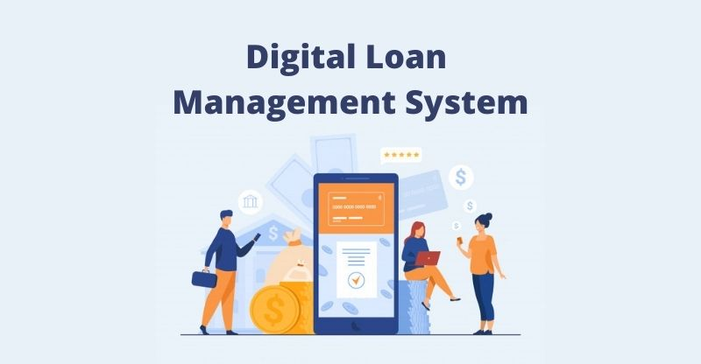


Application Areas(Current Scope)
Credit and Loan Management

Slide 6





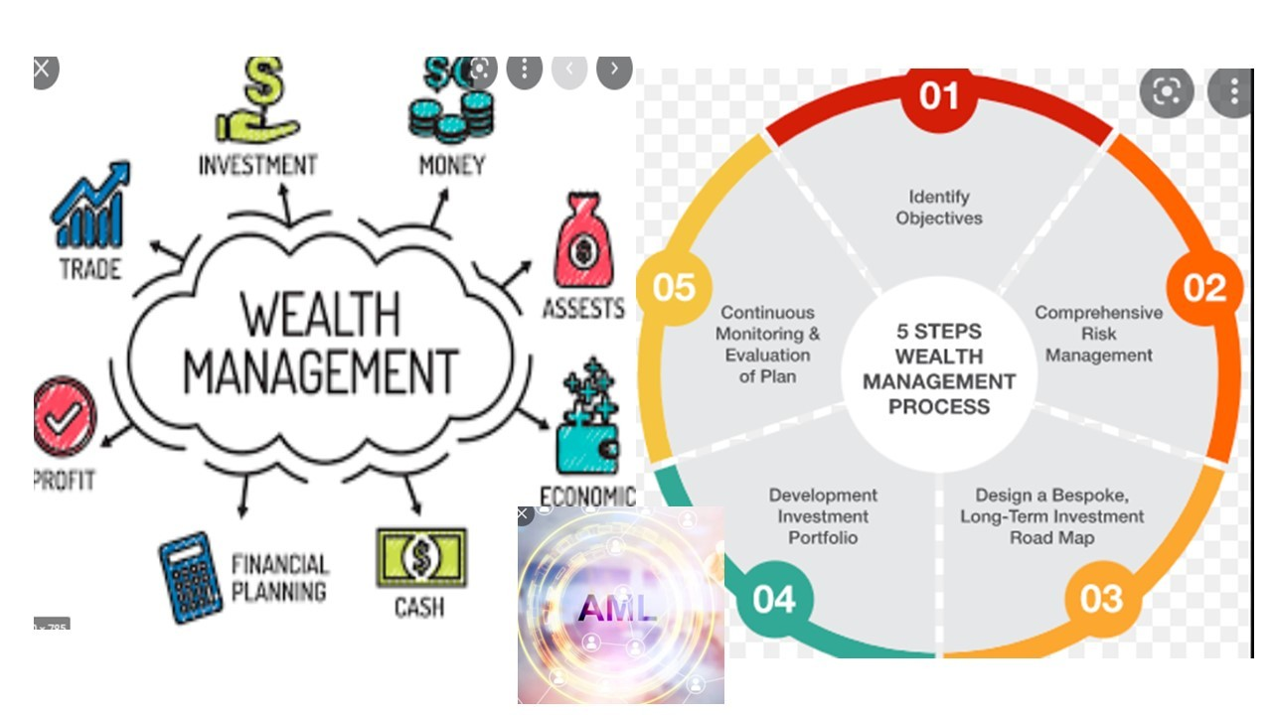

Application Areas(Current Scope)
Investment and Wealth Management

Slide 7

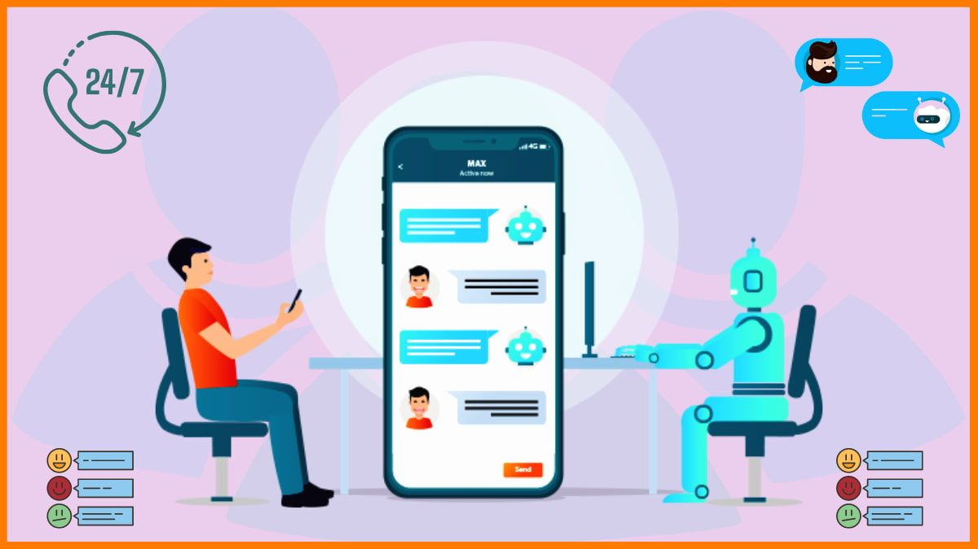
Traditional vs AAICS
Problem
Based on traditional and outdated approaches
Fail to satisfy customer needs
Results in dissatisfaction and inefficiency
Opportunity
Introducing AAICS, a smarter solution to understand, process, evaluate and respond to user queries efficiently.
Goal to enhance customer service in real-time
Help businesses

Slide 8
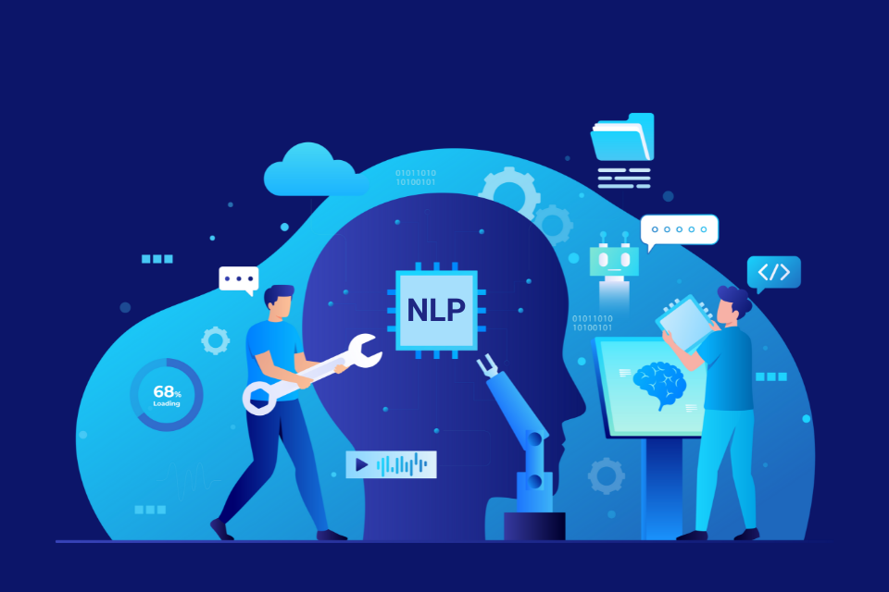
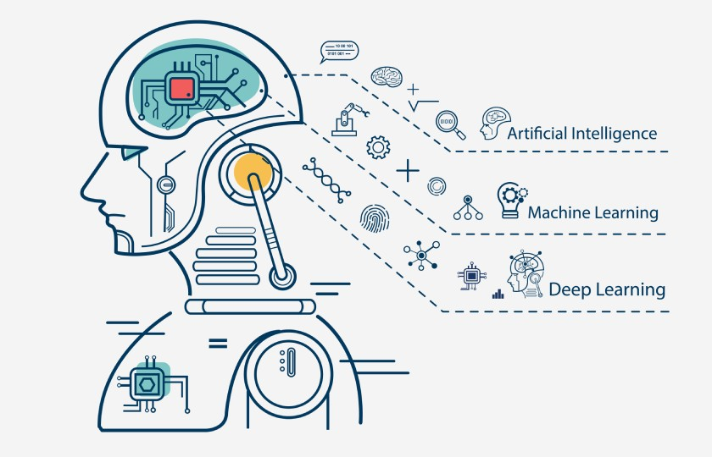

Software Solutions
NLP & Speech Recognition
Better understanding of customer queries
Ability to accurately interpret, process, and manage customer queries by adapting to various linguistic nuances and accents
Machine Learning & Deep Learning
Adaptive learning from customer interactions
Handles complex conversations
Business Operations Integrations
Tailored, relevant, and personalized responses to customers using company data

Slide 9
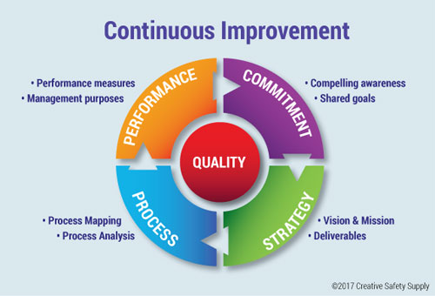
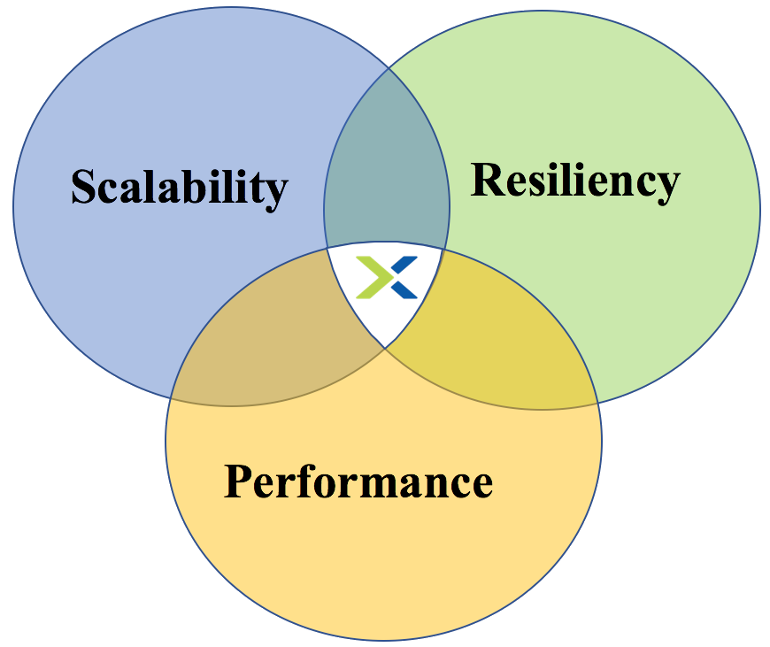
Software Solutions
User-Friendly UI
Easy for both customers and agents
Seamless Human Escalation
Transition conversations to human agents seamlessly, when needed
Quality Control, Continuous Feedback & Improvement
Feedback-driven refinement
Continuous optimization and improvement through feedback
Ensure quality control and reliability
Scalability & Performance
Ready for high volumes and new features
High available and reliable
Seamless integration of new features

Slide 10
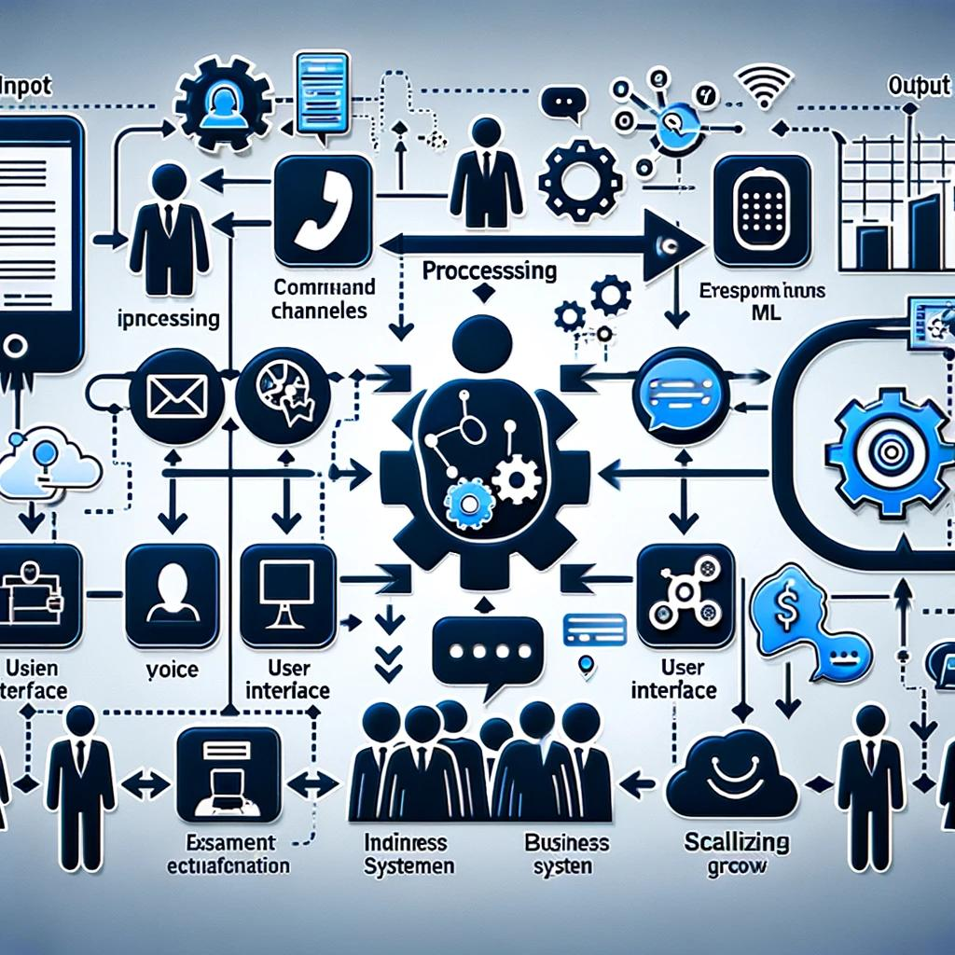
Workflow
Input: Accepts customer inquiries through various channels (voice, text, etc.)
Processing: Leverages advanced AI & ML to understand, process, and respond to inquiries with high accuracy and relevance
Output: Delivers precise, understandable, and helpful responses to customer inquiries, enhancing satisfaction and efficiency

Slide 11
Workflow
Systems provides user friendly interface to both agents and customers.
System is designed to integrate with existing business systems seamlessly and scale to accommodate growing customer service demands

Slide 12
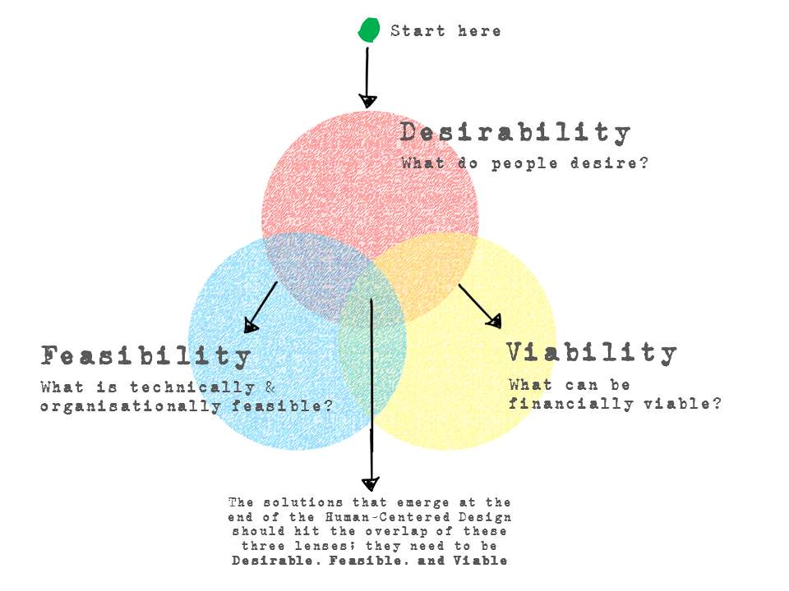
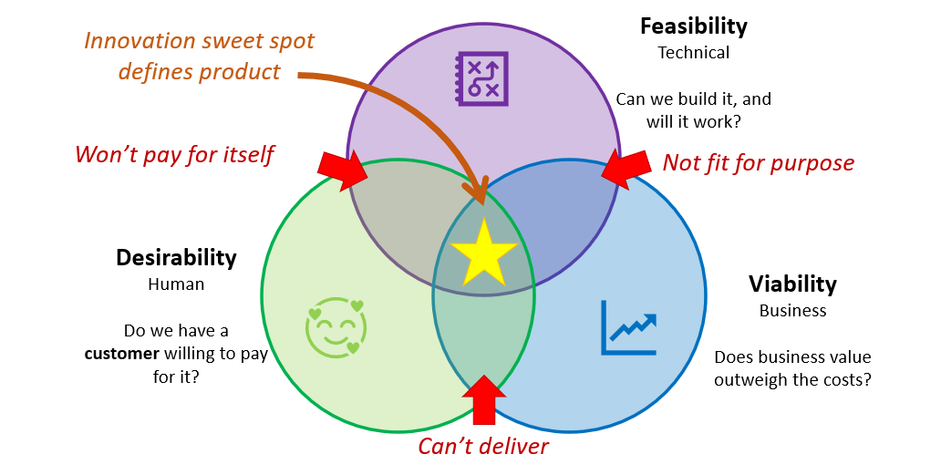
Feasibility and Viability
Objective: Evaluate the feasibility of AAICS across technical, operational, and economic dimension

Slide 13
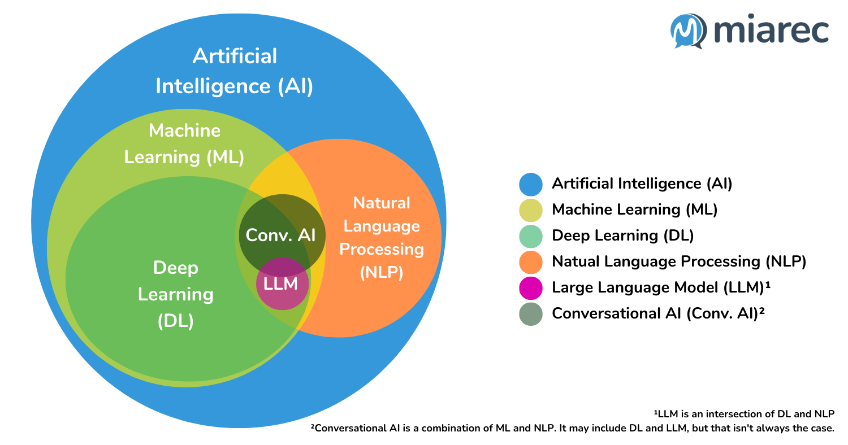
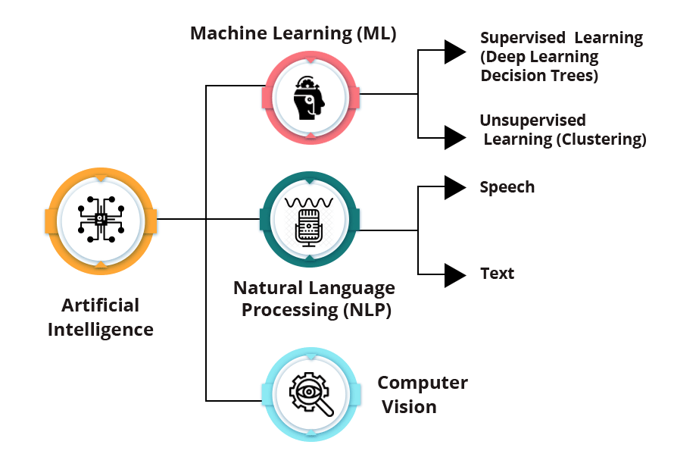
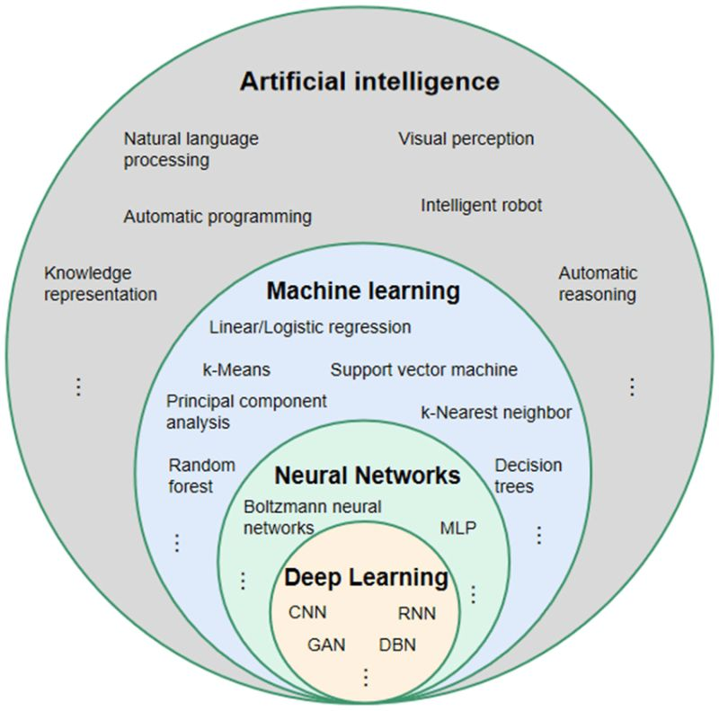
Technical Feasibility Overview
Necessity for advanced technologies: Natural Language Processing (NLP), Machine Learning (ML) / Deep Learning (DL), Backend, Frontend (Mobile or Web), Databases, and more
Challenges in achieving high accuracy across languages and accents.
Importance of data quality for ML / DL model effectiveness .

Slide 14
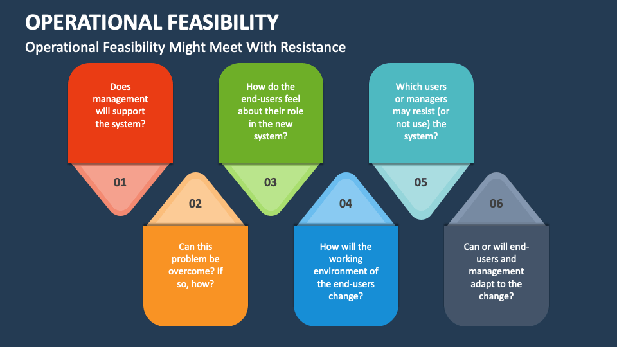
Operational Feasibility Overview
Adjustments required in current operational workflows
Training needs for staff to manage and intervene AI system operations
Integration with existing business systems like CRM and databases

Slide 15
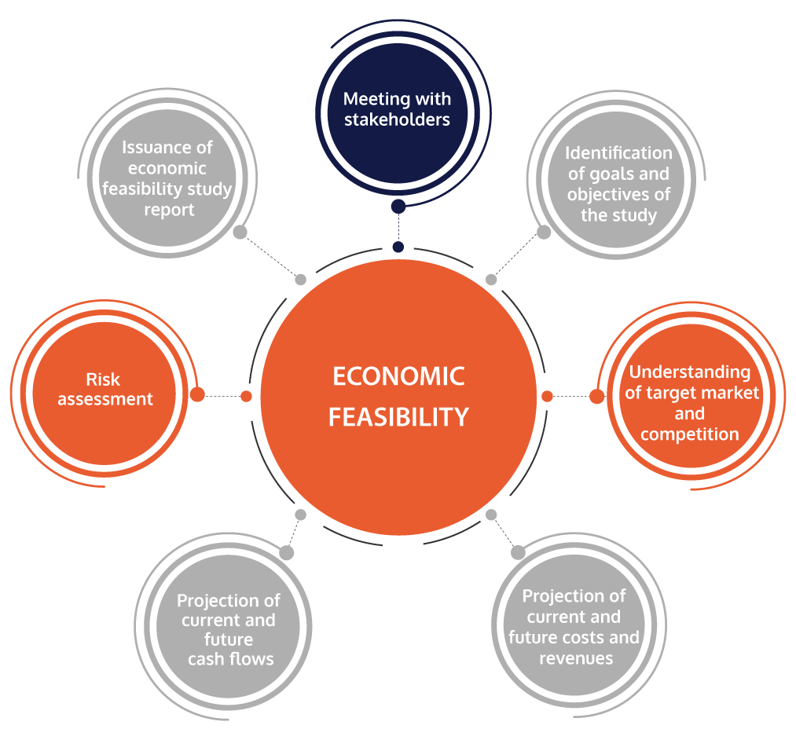
Economic Feasibility Overview
Initial investment vs long-term savings in labor costs and improved customer satisfaction
Scalability of cloud-based AI and ML services to reduce infrastructure costs
Detailed cost-benefit analysis necessity for specific organizational context

Slide 16
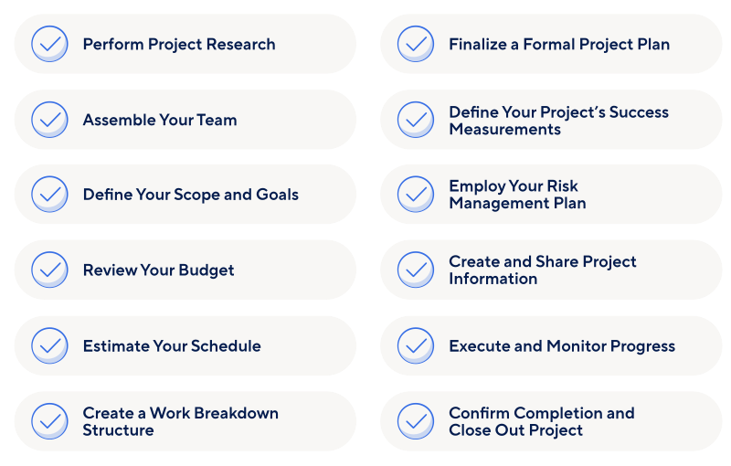
Project Plan

Slide 17
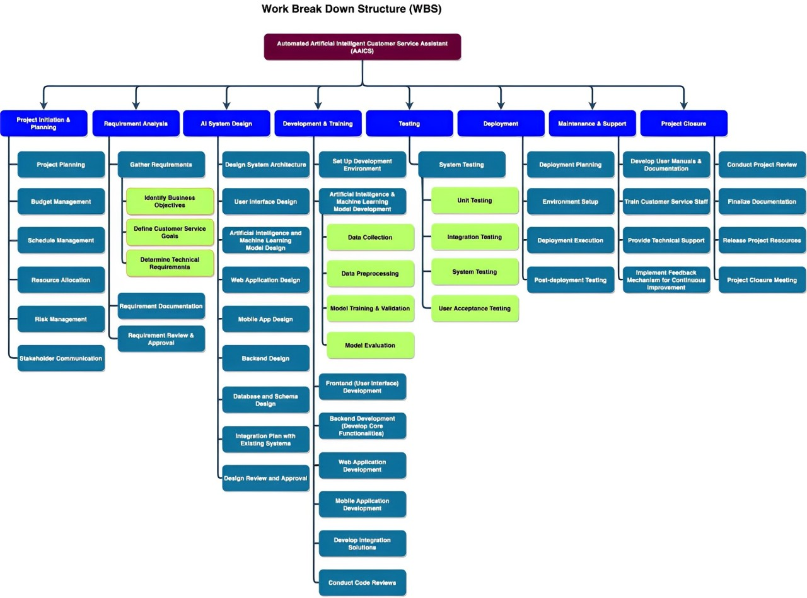
WBS

Slide 18
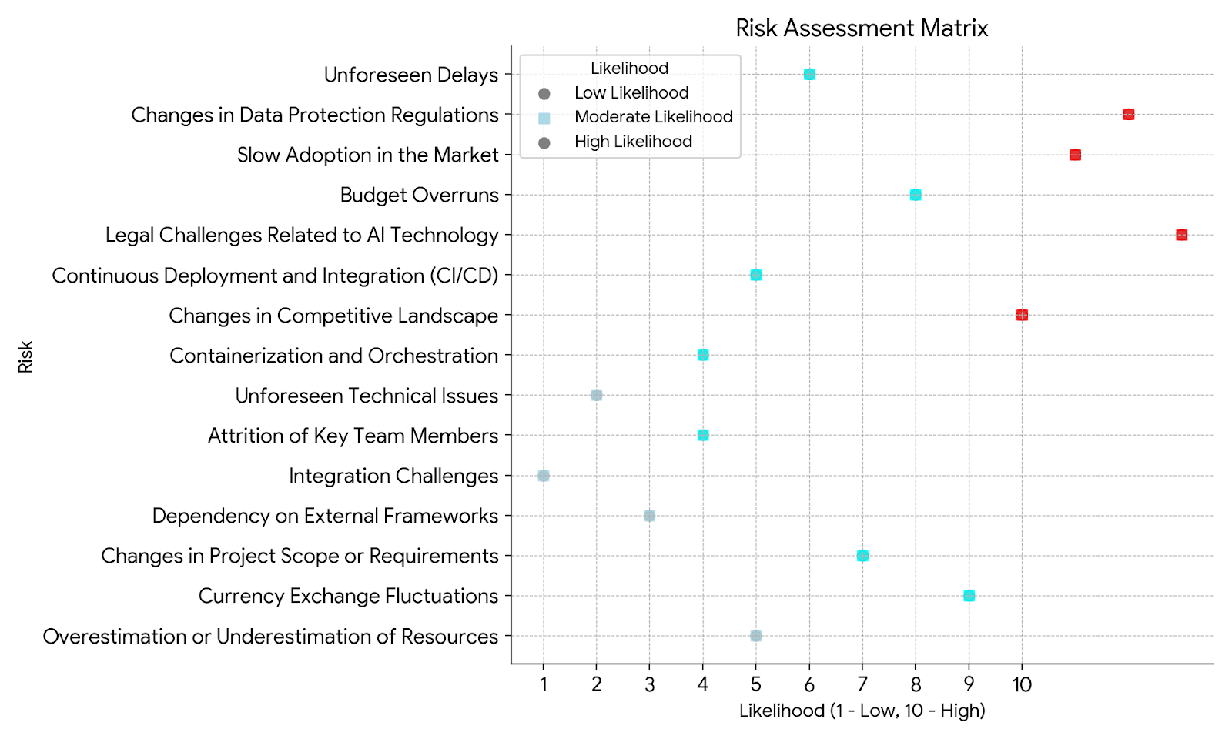
Risk Management : Types and Impact
By considering both likelihood and impact, you can prioritize risks and allocate resources for mitigation efforts. For example, a risk with a high likelihood and high impact should be addressed first, even if there are other risks with a higher impact but lower likelihood.

Slide 19
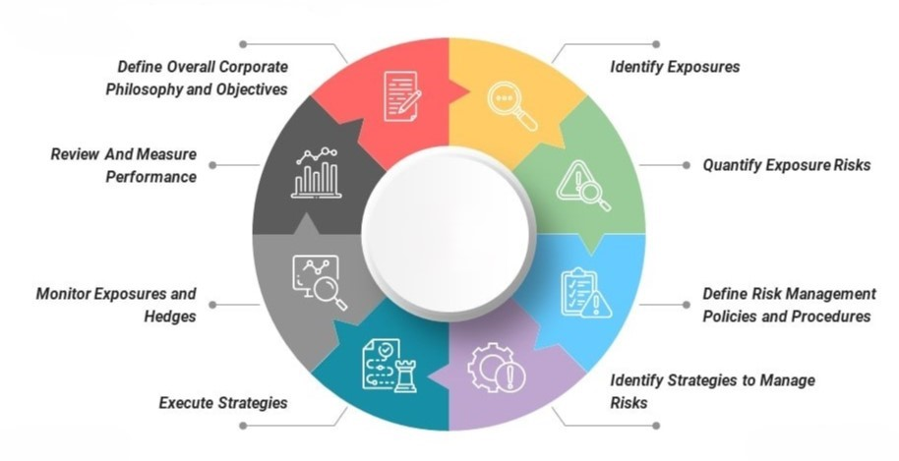
Risk Management

Slide 20
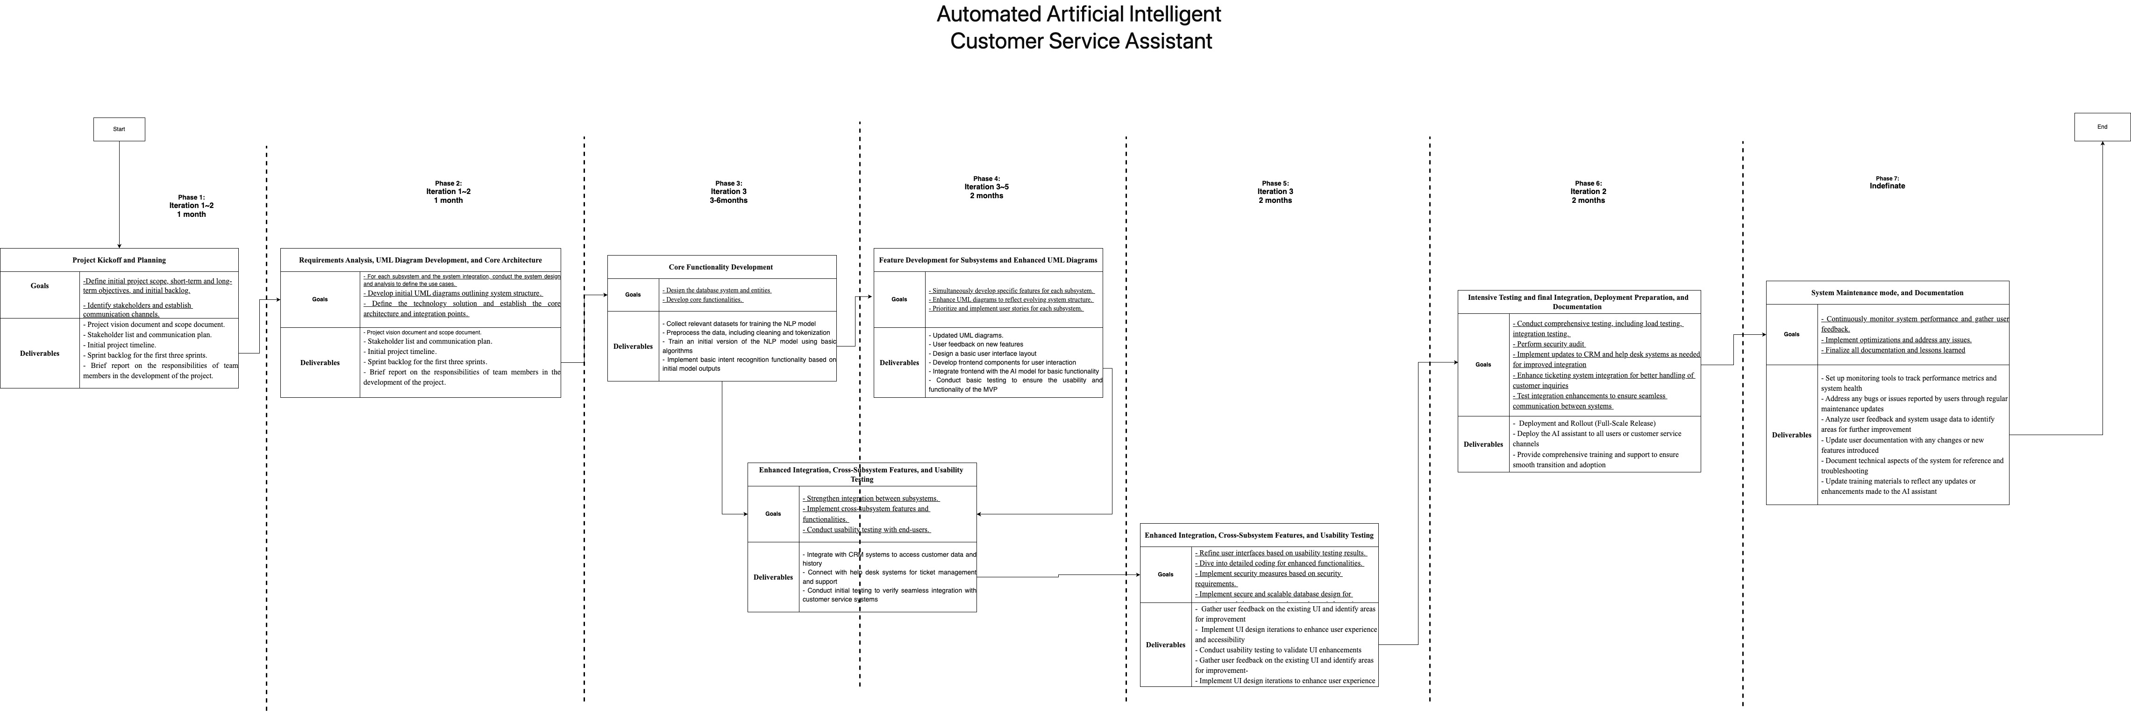
Milestone for each iteration

Slide 21
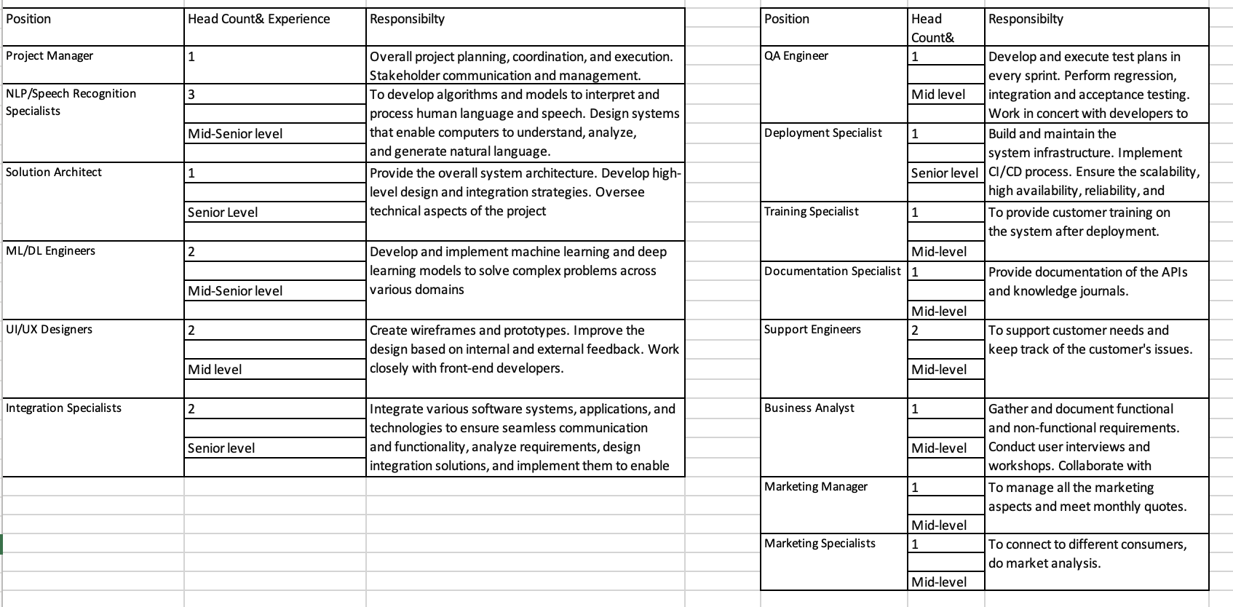
Resource Planning

Slide 22
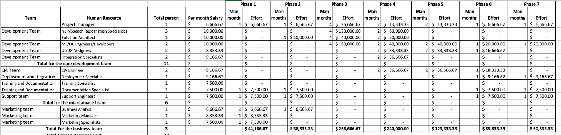
Budget by Sprint/Phase

Slide 23
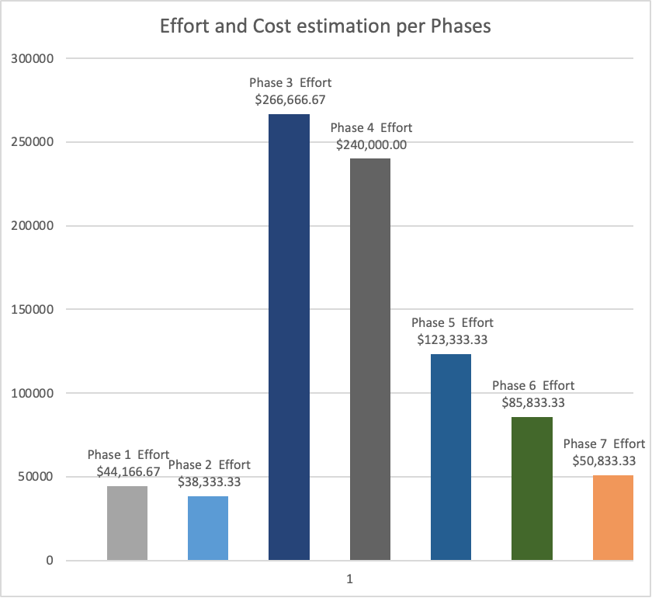
Budget & Costing
Phases 3 and 4 likely have the most costly man-months because they involve significant development efforts and iterations to create and refine the core functionality and features of the AI customer service assistant.

Slide 24
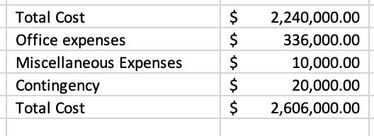
Total budget with contingency plan

Slide 25
Conclusion
AAICS has advantage such as:
•Adapt to various languages and accents
•Understand complex inquiries
•Fulfilling customer’s Request
•Maintain and manage contextual conversations
•Enable smooth handoffs to human agents.
•Personalize customer interactions
•Learn and improve continuously
Our Project:
The projects will be developed in iterations, each lasting 9-12 months.
With total cost including resource + other expense+ contingency: $2,606,000.00

Slide 26


Thank you so much for your attention

